Slide 1
Chapter 20
File Transfer
Protocol
(FTP)

Slide 2
CONTENTS
CONNECTIONS
COMMUNICATION
COMMAND PROCESSING
FILE TRANSFER
USER INTERFACE
ANONYMOUS FTP

Slide 3

FTP uses the services of TCP.
It needs two TCP connections.
The well-known port 21 is used
for the control connection
and the well-known
port 20 for the data connection.

Slide 4
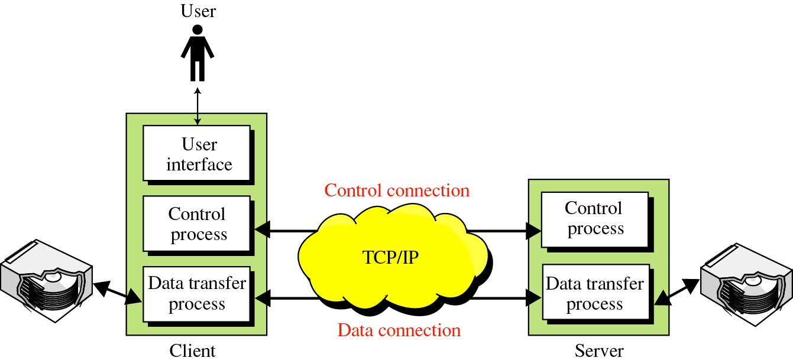
Figure 20-1
FTP

Slide 5
20.1
CONNECTIONS

Slide 6
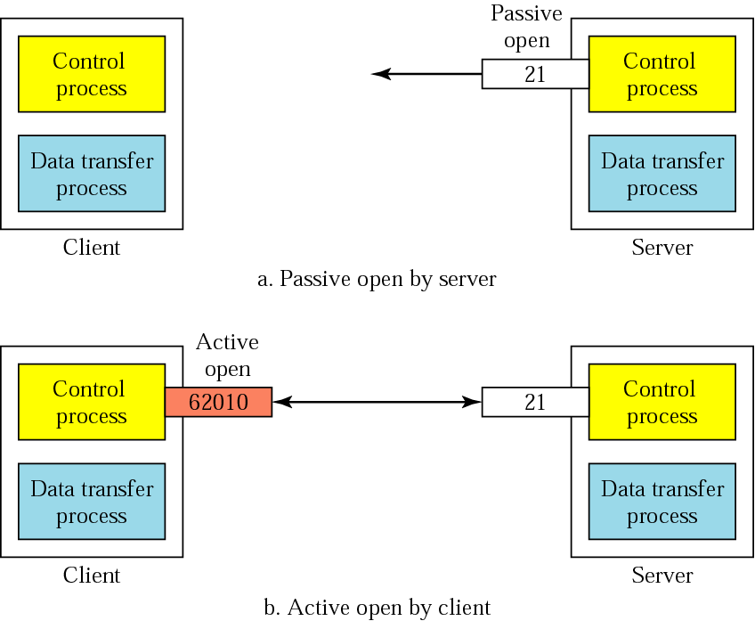
Figure 20-2
Opening the control connection

Slide 7
20.2
COMMUNICATION

Slide 8
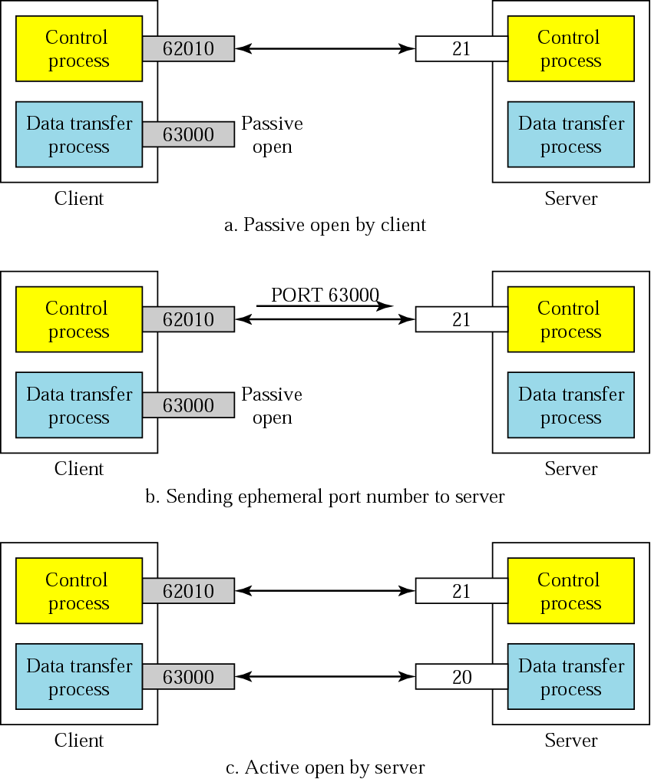
Figure 20-3
Creating
the data
connection

Slide 9
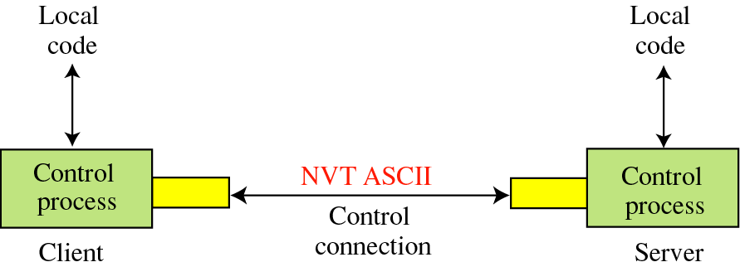
Figure 20-4
Using the control connection

Slide 10
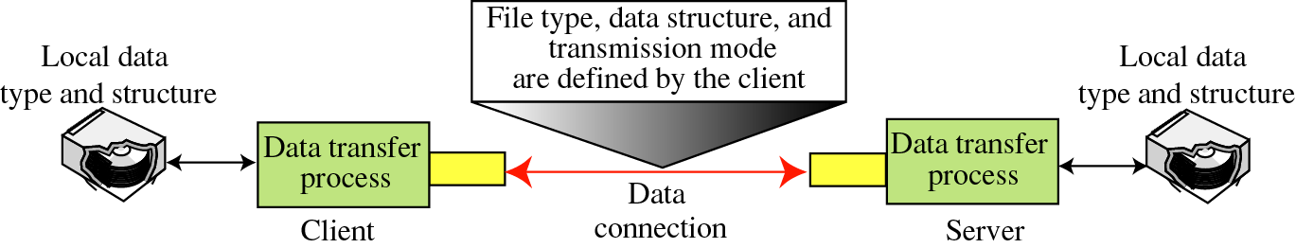
Figure 20-5
Using the data connection

Slide 11
20.3
COMMAND
PROCESSING

Slide 12
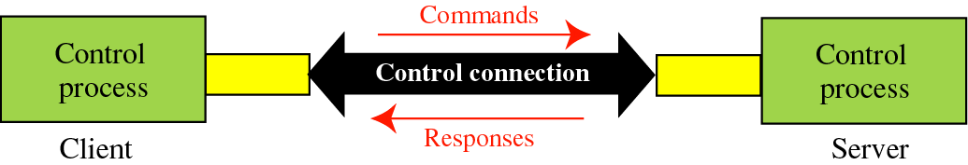
Figure 20-6
Command processing

Slide 13
20.4
FILE
TRANSFER

Slide 14
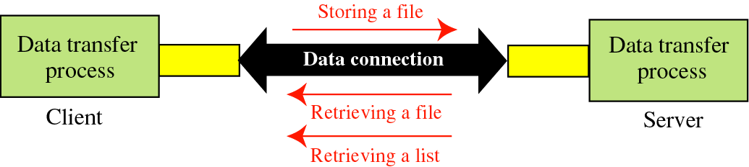
Figure 20-7
File transfer

Slide 15
Example 1
Figure 20.8 shows an example of using FTP for retrieving a list of items in a directory.

Slide 16
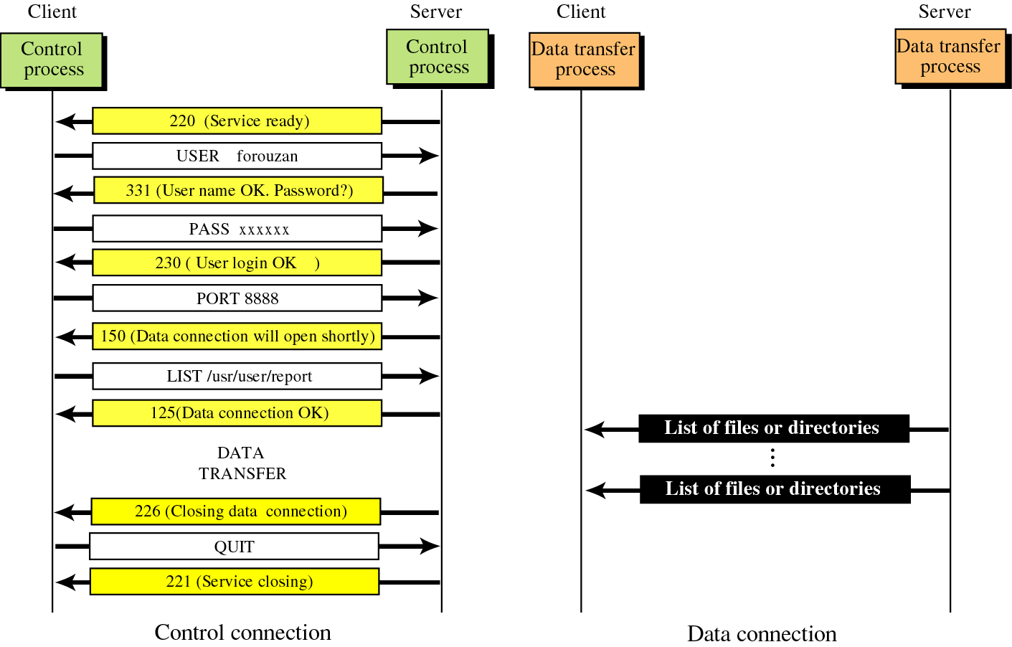
Figure 20-8
Example 1

Slide 17
Example 2
Figure 20.9 shows an example of how an image (binary) file is stored.

Slide 18
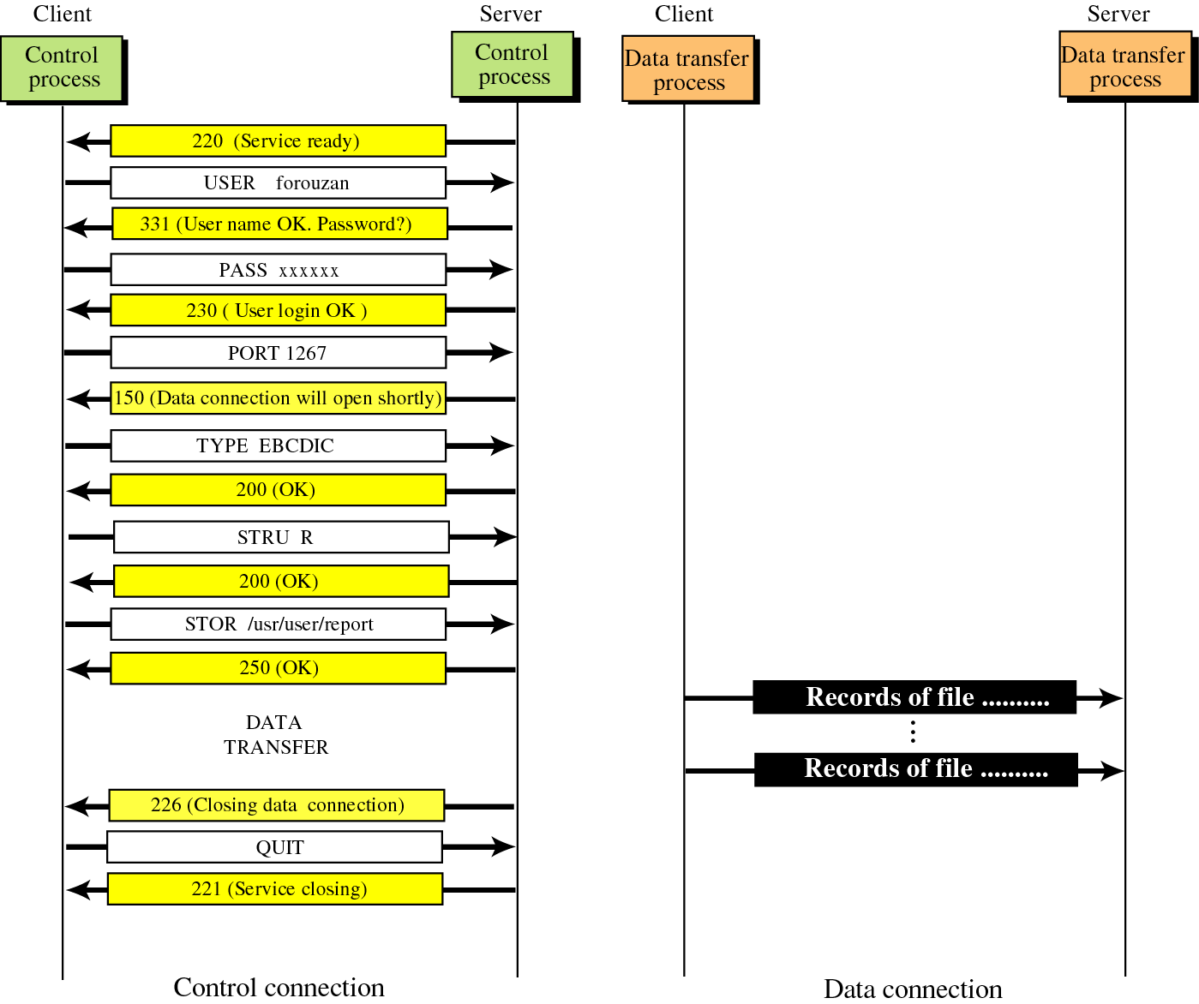
Figure 20-9
Example 2

Slide 19
20.5
USER
INTERFACE

Slide 20
Example 3
We show some of the user interface commands that accomplish the same task as in Example 1.

Slide 21
Solution
% ftp challenger.atc.fhda.edu
Connected to challenger.atc.fhda.edu
220 Server ready
Name: forouzan
Password: xxxxxxx
ftp > ls /usr/user/report
200 OK

Slide 22
Solution
150 Opening ASCII mode
...........
226 transfer complete
ftp > close
221 Goodbye
ftp > quit

Slide 23
20.6
ANONYMOUS
FTP

Slide 24
Example 4
We show an example of using anonymous FTP. We assume that some public data are available at internic.net.

Slide 25
Solution
% ftp internic.net
Connected to internic.net
220 Server ready
Name: anonymous
331 Guest login OK, send “guest” as password
Password: guest
ftp > pwd
257 ’/’ is current directory

Slide 26
Solution
ftp > ls
200 OK
150 Opening ASCII mode
bin
…
ftp> close
221 Goodbye
ftp> quit

